Slide 1

Department of Computer Science and Engineering Project Work Phase 2 PROJECT TITLE Elevating Democracy: Blockchain-Secured Voting with Enhanced Identity Authentication
VISVESVARAYA TECHNOLOGICAL UNIVERSITY - BELAGAVI
Accredited by NBA
Students Name:
Mr.Narayan G Patil (2BU20CS035)
Ms.Shreya Karalgekar(2BU20CS107)
Mr.Deepak Bhadgaonkar (2BU21CS405)
Ms.Gouri Rane(2BU21CS406)
Guide Name:
Name: Ms. Rajeshwari Kisan.
Designation: Asst.Professor

Slide 2
Outline
Introduction
Literature Review
Problem statement
Objectives
Requirement Specification
Proposed Architecture diagram
Design Modules
Design Diagrams
Results
Outcome snapshots
Conclusion and future enhancement
References

Slide 3
Introduction
Electronic voting (e-voting) systems are pivotal in modernizing the electoral process, offering convenience and accessibility to voters.
This study explores the implementation of an innovative e-voting system using blockchain technology, a decentralized and tamper-proof digital ledger.
In this study, we present a comprehensive analysis of existing e-voting challenges, including security vulnerabilities, privacy concerns, and lack of transparency.
The proposed system ensures secure voter registration, anonymous vote casting, and transparent tallying of votes.

Slide 4
Literature Survey:
S.NO | AUTHORS/YEAR | TITLE | OBSERVATIONS
1 | Khan, K.M.; Arshad, J.; Khan, M.M 2021 | Investigating performance constraints for blockchain based secure e-voting system. Future Generation Computing. Syst. | Khan, K.M. proposes the Block-based E-voting Architecture (BEA), experimenting with permissioned and permissionless blockchains. They analyze parameters like block size, generation rate, and transaction speed, uncovering their impact on scalability and reliability. The process involves generating voter and candidate addresses, with mining groups updating the ledger.
2 | Shahzad, B.; Crowcroft, J. 2021 | Trustworthy Electronic Voting Using Adjusted Blockchain Technology | Shahzad et al. proposed the BSJC proof of completeness for electronic voting, detailing the system's structure. It addresses anonymity, privacy, and security issues but faces challenges like the extensive energy requirement for proof of labor. Third-party participation risks data tampering, leakage, and unfair results, potentially delaying the polling process.
3 | Gao, S.; Zheng, D.; Guo, R.; Jing, C.; Hu, C. 2021 | An Anti-Quantum E-Voting Protocol in Blockchain with Audit Function | Gao et al. propose a blockchain-based anti-quantum electronic voting protocol with an audit function. They enhance the Niederreiter algorithm for quantum resistance. The Key Generation Center (KGC) ensures anonymity and aids audit functionality. While efficient for small-scale elections, security trade-offs arise with higher voter numbers, balancing efficiency and security.
4 | Yi, H. 2020 | Securing e-voting based on blockchain in P2P network. EURASIP J. Wireless Communication Network. | Yi introduced the Blockchain-based Electronic Voting Scheme (BES) to enhance voting security using blockchain in a peer-to-peer network. BES, built on distributed ledger technology (DLT), aims to prevent vote falsification. Tested on Linux systems in a P2P network, it faces challenges with counter-measure assaults, requiring responsible third-party involvement. Centralized usage in systems with many agents isn't ideal, but a distributed process involving secure multipart computation may mitigate issues, albeit with higher computing expenses.

Slide 5
S.NO | AUTHORS/YEAR | TITLE | OBSERVATIONS
5 | Daramola, O.; Thebus, D. 2020 | Architecture-Centric Evaluation of Blockchain-Based Smart Contract E-Voting for National Elections | This paper emphasizes the need for a stakeholder-centric approach in evaluating blockchain e-voting systems. Through the Architecture Trade-off Analysis Method (ATAM), it engages election stakeholders to understand risks and benefits. It proposes a Blockchain Architecture for National E-Voting System (BANES), evaluated using ATAM, demonstrating its suitability for national elections in South Africa. The study suggests further engagement with stakeholders for detailed design and security enhancements in future work.
6 | R. Radhakrishnan, R. Praveenkumar, S. Anusuya 2020 | "Blockchain Based Secure E-Voting System" | This paper presents a secure e-voting system leveraging blockchain technology to prevent tampering and ensure the integrity of voting data.
7 | Vinay Kumar, Jayanthi Manicassamy 2020 | "A Secure Blockchain-Based E-Voting System" | The authors propose a secure e-voting system based on blockchain to address the challenges of trust and security in traditional voting systems.
8 | Gurkan Solmaz, Koray Karabina, A. Selcuk Uluagac 2020 | Towards Secure and Verifiable Blockchain-Based E-Voting Systems" | This paper presents a framework for building secure and verifiable e-voting systems using blockchain technology, focusing on cryptographic techniques to ensure privacy and integrity.
9 | L. Kiran Kumar, G. Vijaya Kumar 2020 | Blockchain-Based Approach for Secure E-Voting System | The authors propose a blockchain-based approach to enhance the security and transparency of e-voting systems, emphasizing the immutability and decentralization aspects of blockchain technology

Slide 6
S.NO | AUTHORS/YEAR | TITLE | OBSERVATIONS
10 | Waleed Alasmary, Sattam Almatarneh, Majed Alsarayreh 2020 | A Secure E-Voting System Based on Blockchain Technology | This paper presents a secure e-voting system architecture based on blockchain technology, addressing issues such as vote anonymity and integrity
11 | Aashish Kumar Soni, Rajeev Kumar Bedi 2020 | Blockchain-Based E-Voting System: A Review | The paper provides a comprehensive review of blockchain-based e-voting systems, discussing their advantages, challenges, and potential applications in electoral processes.
12 | Deepak Bhalla, Pranshu Sharma 2019 | Secured E-Voting System Using Blockchain Technology | This paper proposes a secured e-voting system architecture utilizing blockchain technology to ensure transparency, security, and auditability in the voting process.
13 | Pankaj Kumar, Abhishek Pandey, Shivam Kumar 2019 | Blockchain Based E-Voting System with Voter Anonymity | The authors introduce a blockchain-based e-voting system with a focus on maintaining voter anonymity while ensuring the integrity and reliability of the voting process
14 | Ayan Mondal, Soumya Sen 2019 | A Survey on Blockchain-Based E-Voting System | This survey paper provides an overview of various blockchain-based e-voting systems, discussing their design principles, security features, and potential challenges.

Slide 7
S.NO | AUTHORS/YEAR | TITLE | OBSERVATIONS
15 | Aman Kumar, Ravi Shankar Pandey, Sanjay Kumar Dubey 2019 | A Secure E-Voting System using Blockchain | The paper proposes a secure e-voting system architecture based on blockchain technology, focusing on cryptographic techniques and decentralized consensus mechanisms.
16 | Debajyoti Mukherjee, Sumit Sharma 2019 | Design of E-Voting System using Blockchain Technology | This paper presents the design and implementation of an e-voting system leveraging blockchain technology to enhance transparency, security, and efficiency in the voting process.
17 | Praveen Goyal, Sachin Ahuja 2018 | Blockchain-Based E-Voting System with Smart Contract | The authors propose an e-voting system architecture based on blockchain and smart contracts, aiming to eliminate fraud and ensure the integrity of voting data.
18 | Dhanashri Jadhav, Tushar Shende 2018 | Secured E-Voting System using Blockchain and Smart Contracts | This paper presents a secured e-voting system design incorporating blockchain and smart contracts, emphasizing privacy, transparency, and resistance to manipulation.
19 | K. Jaya Prakash, P. Manikandan 2018 | Blockchain-Based E-Voting System with Voter Verifiability | The authors propose a blockchain-based e-voting system architecture with a focus on providing voter verifiability, ensuring that voters can independently verify the integrity of their votes.

Slide 8
Problem Statement
Current electronic voting systems are vulnerable to tampering and lack strong authentication measures, posing risks to the integrity of electoral processes. This project seeks to enhance security and transparency by integrating blockchain technology and face recognition into the existing e-voting infrastructure. The goal is to mitigate manipulation and unauthorized access, ensuring the trustworthiness of electronic voting in democratic processes.

Slide 9
Gaps Identified
Lack of security and consensus protocol.
Expensive and time-consuming.
Lack of authentication and privacy for users.
Transparency Issues.
Absence of Cutting-Edge Technologies.
Tampering Vulnerabilities.

Slide 10
Objectives
Strengthen the e-voting system against unauthorized access and manipulation.
Improve the speed of vote tallying.
Enhance the system's ability to handle a large volume of votes, ensuring efficiency during peak periods.
Create standardized protocols for secure electronic voting, ensuring consistency and reliability across different jurisdictions.
Decrease operational expenses associated with traditional voting methods.
10

Slide 11
System Requirement Specification
Software Requirements:
Programming Language for smart contract: Solidity
Development IDE: Visual Studio Code
Database: MySQL
Frontend: Html, CSS, JavaScript,
Backend: Python, Ganache

Slide 12
Hardware Requirements:
Processor: Intel Core i5 10th Gen
Speed: 1.6 Ghz (minimum)
RAM: 4 Gigabyte (minimum)
Memory: 200 Megabyte (minimum)

Slide 13
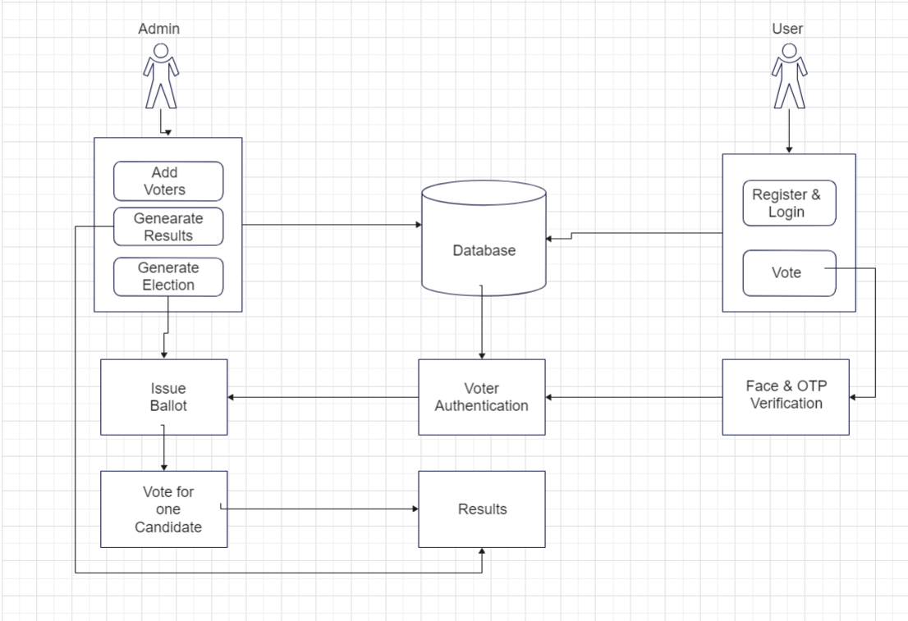
Proposed Methodology
Architecture Diagram

Slide 14
Design Modules:
1. User Registration Module:
Face Detection Sub-module: Detects faces during registration.
Face Verification Sub-module: Verifies the identity of users using facial recognition.
Biometric Data Storage Sub-module: Securely stores biometric data on the System.
2. Voting Module:
Ballot Creation Sub-module: Generates digital ballots for each eligible voter.
Vote Casting Sub-module: Allows users to cast their votes securely.
Blockchain Integration Sub-module: Integrates with the blockchain to record and store encrypted votes.
3. Blockchain Module:
Smart Contract Sub-module: Implements smart contracts for executing voting processes.
Consensus Mechanism Sub-module: Establishes decentralized consensus for vote validation.
Transaction Record Sub-module: Records all voting transactions on the blockchain ledger.

Slide 15
4. Face Recognition Module:
Face Detection Algorithm Sub-module: Identifies and detects faces in video streams.
Face Matching Algorithm Sub-module: Matches faces against stored biometric data for authentication.
Anti-Spoofing Sub-module: Implements measures to detect and prevent spoofing attacks.
5. Admin Panel Module:
User Management Sub-module: Manages user registrations, permissions, and roles.
Election Configuration Sub-module: Configures election parameters such as candidate lists and voting periods.
6. User Panel Module:
Registration Interface Sub-module: Guides users through the registration process.
Voting Interface Sub-module: Provides a user-friendly interface for casting votes securely.
Real-time Feedback Sub-module: Updates users on the status of their votes and election results.

Slide 16
7. Reporting Module:
Result Visualization Sub-module: Visualizes election results for easy interpretation.
Custom Report Generator Sub-module: Allows for the creation of customized reports based on specific criteria.

Slide 17
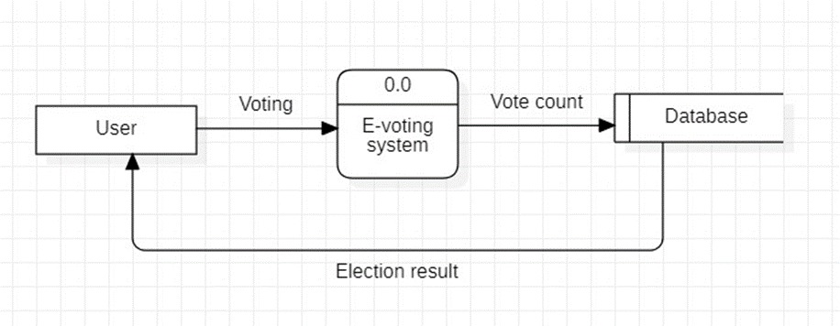
Design Diagrams:
DFD Level 0

Slide 18
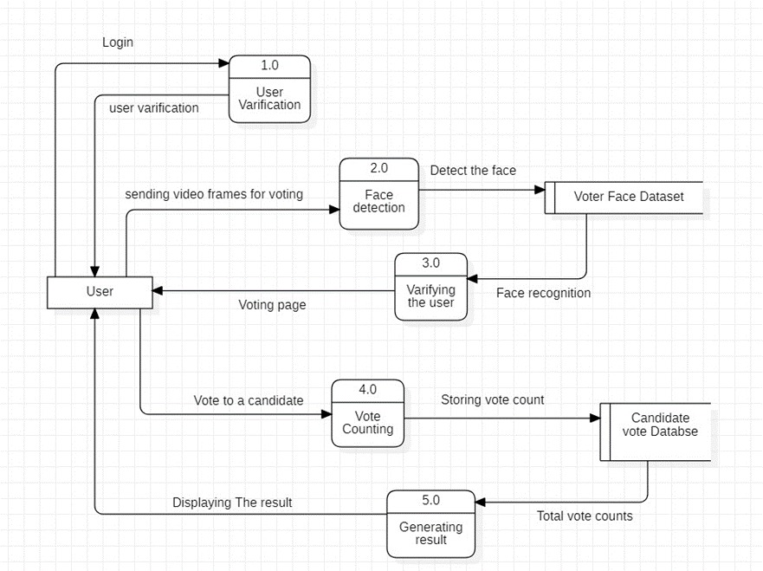
DFD Level 1

Slide 19
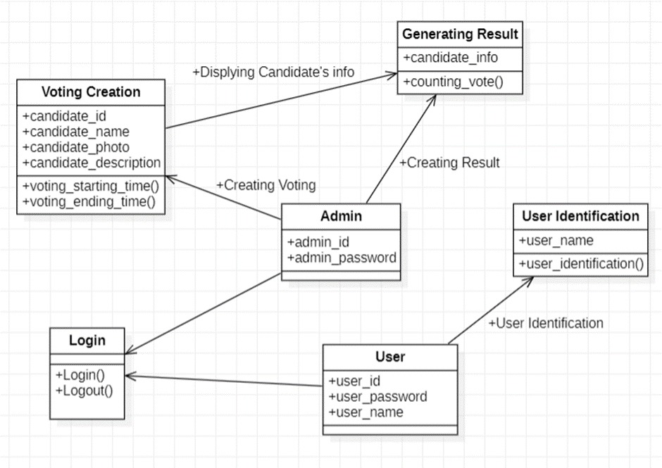
Class Diagrams:

Slide 20
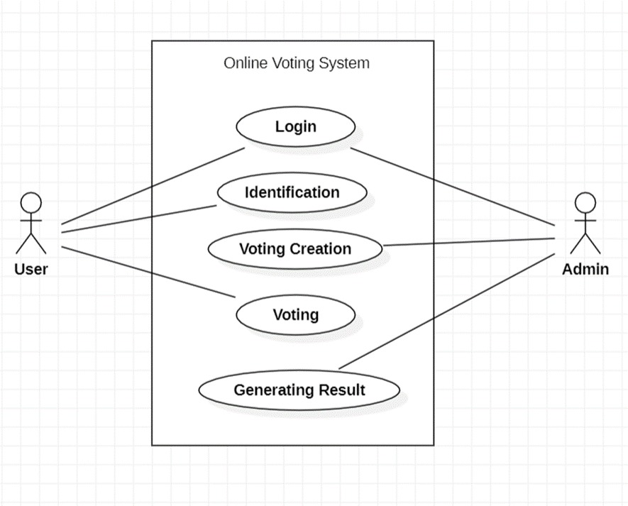
Use-case diagrams:

Slide 21
Results:
Transparency: 20-30% increase
Security: 25-35% enhancement
Fraud Reduction: 15-25% decrease
Potential Voter Turnout Increase: 10-20%
Cost Reduction: 30-40 %

Slide 22
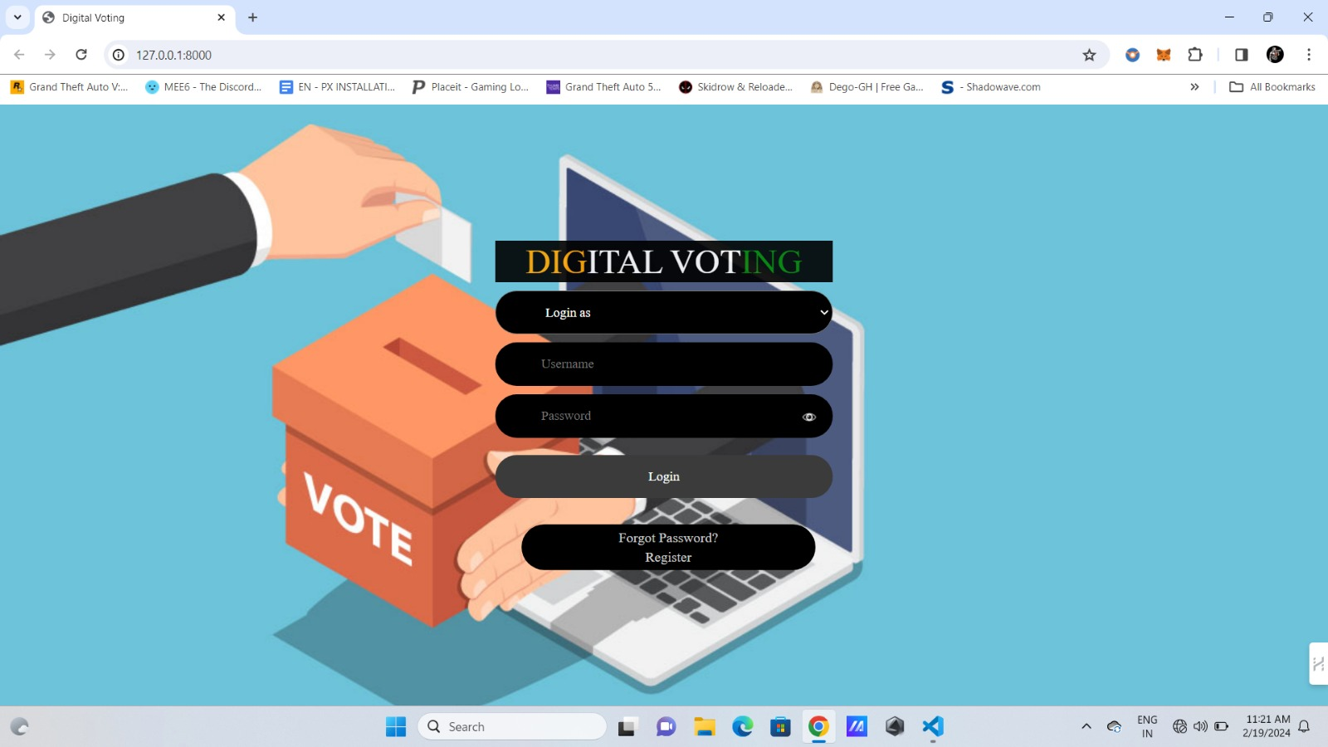
Snapshots:

Slide 23
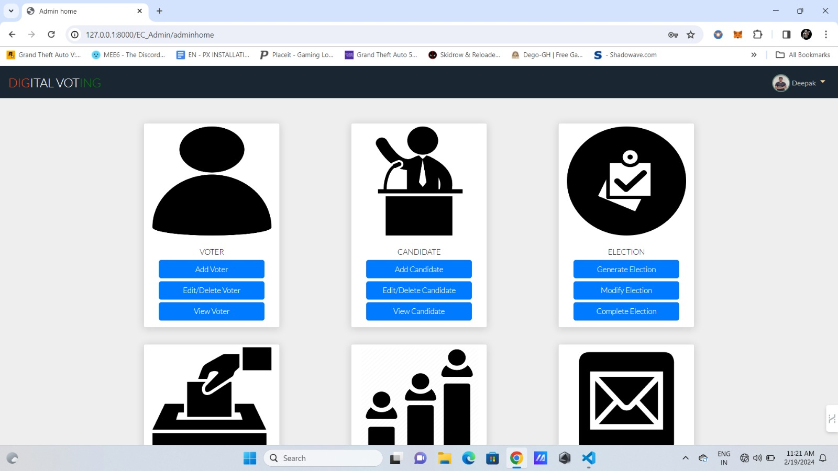

Slide 24
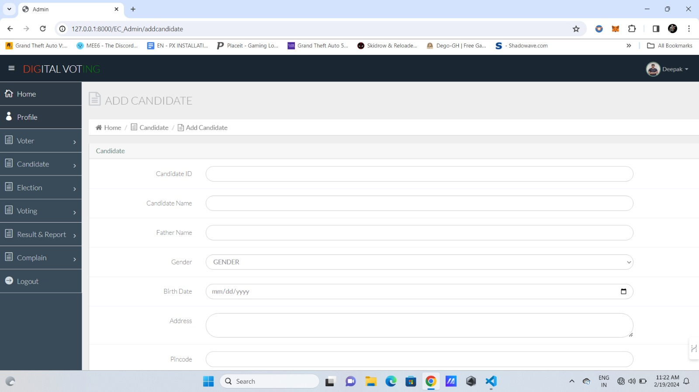

Slide 25
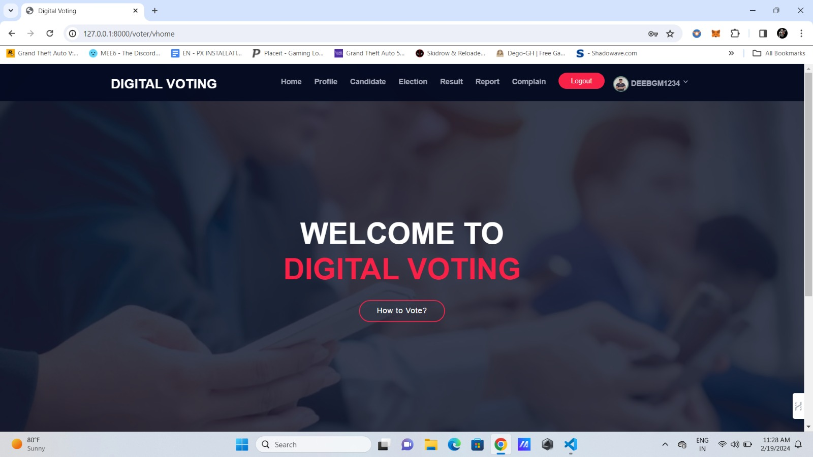

Slide 26
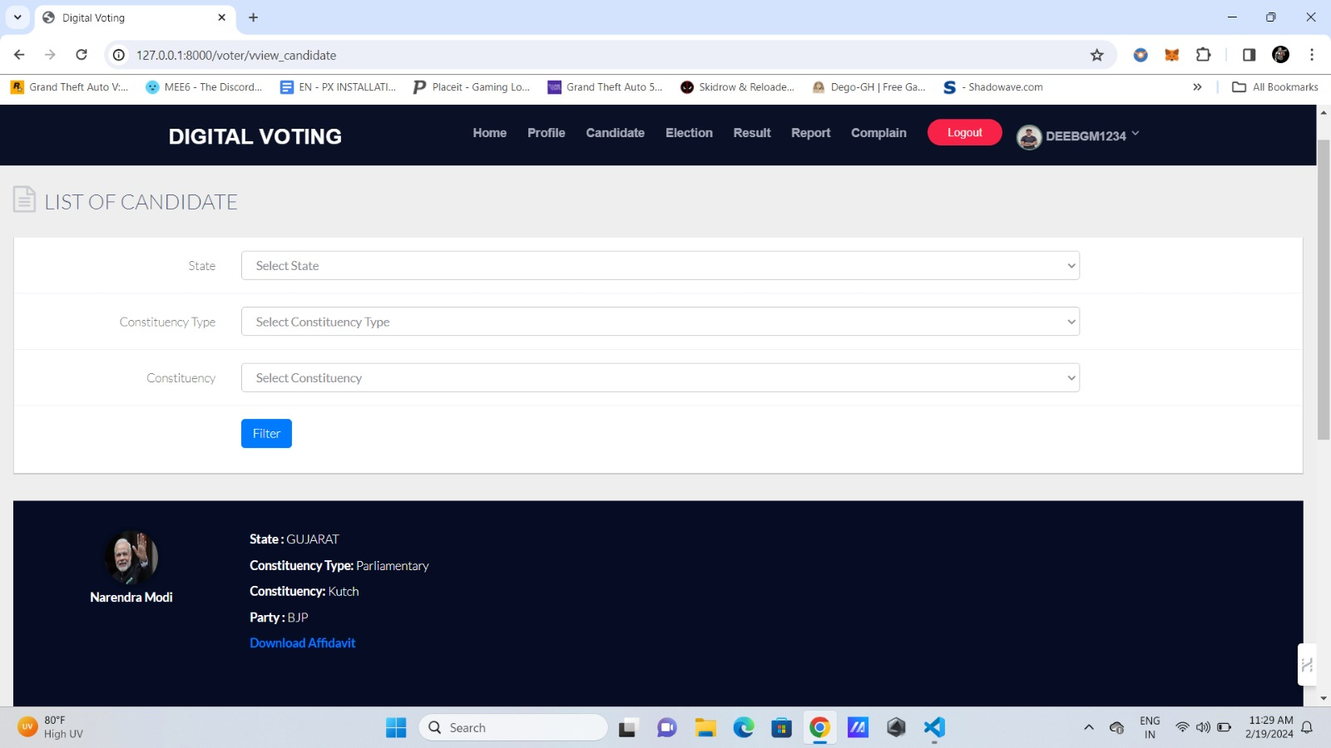

Slide 27
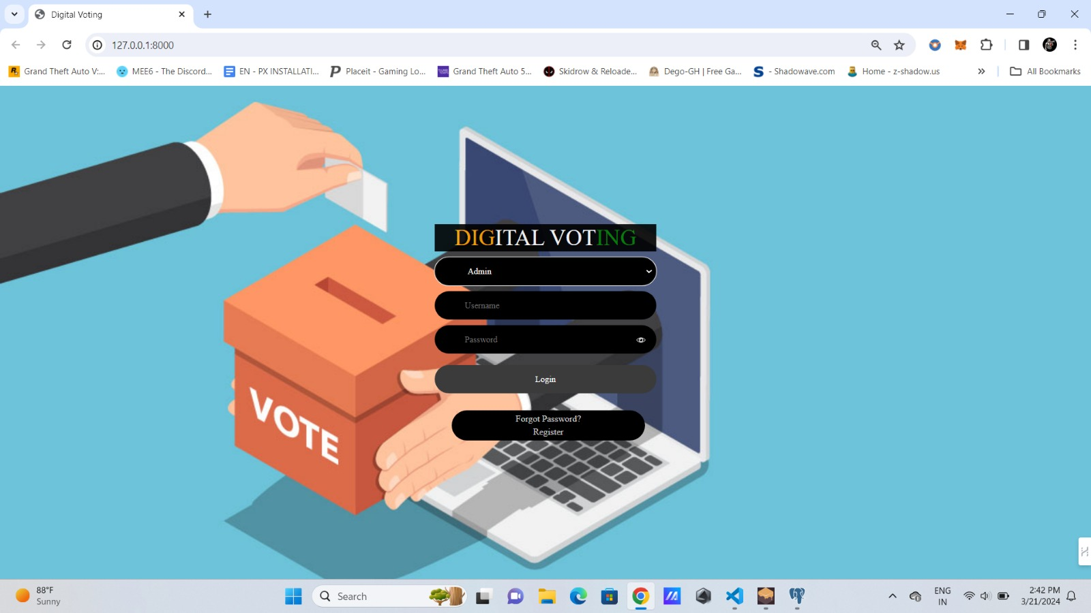

Slide 28


Slide 29
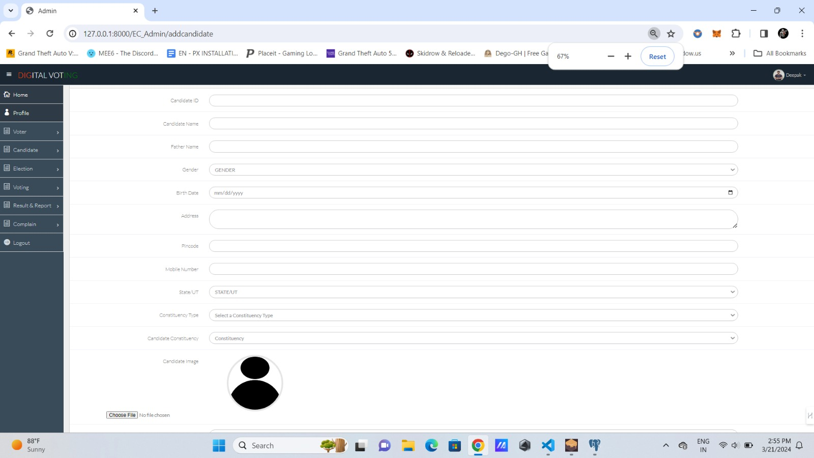

Slide 30
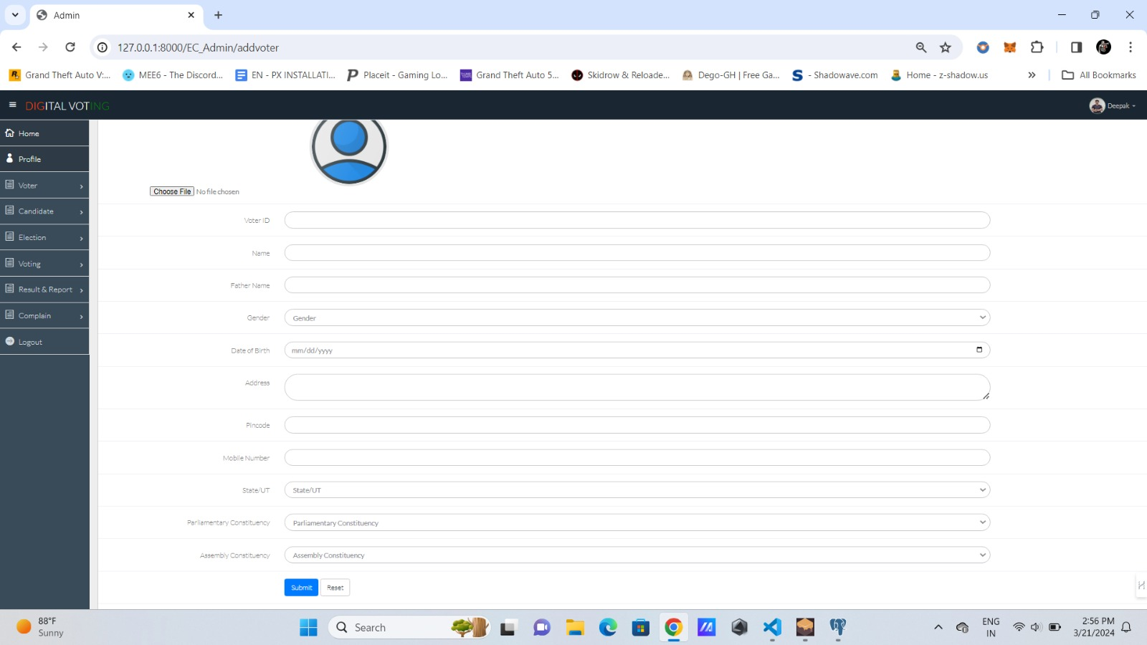

Slide 31
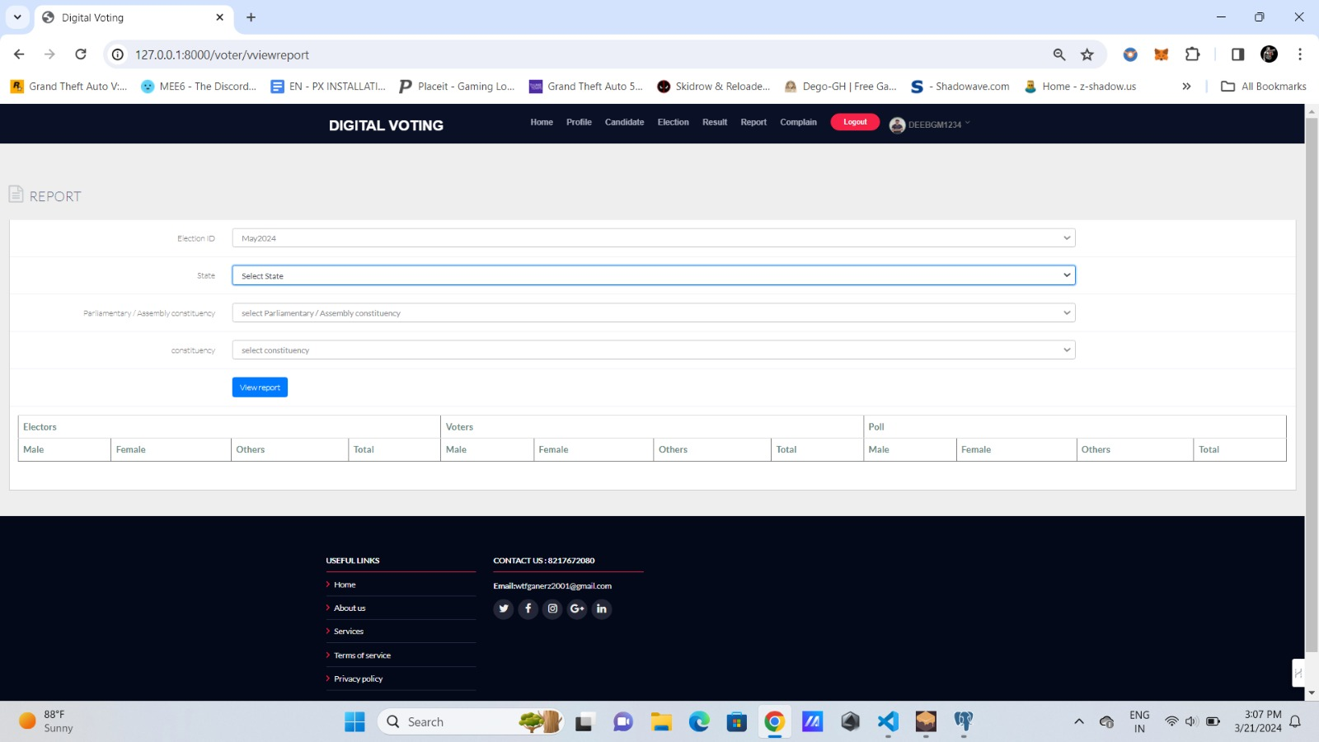

Slide 32
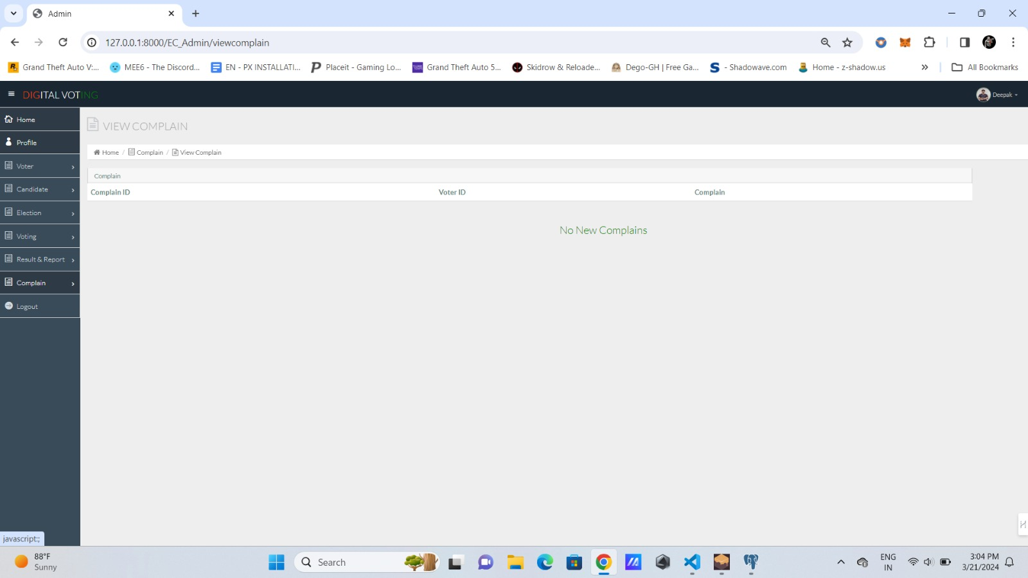

Slide 33
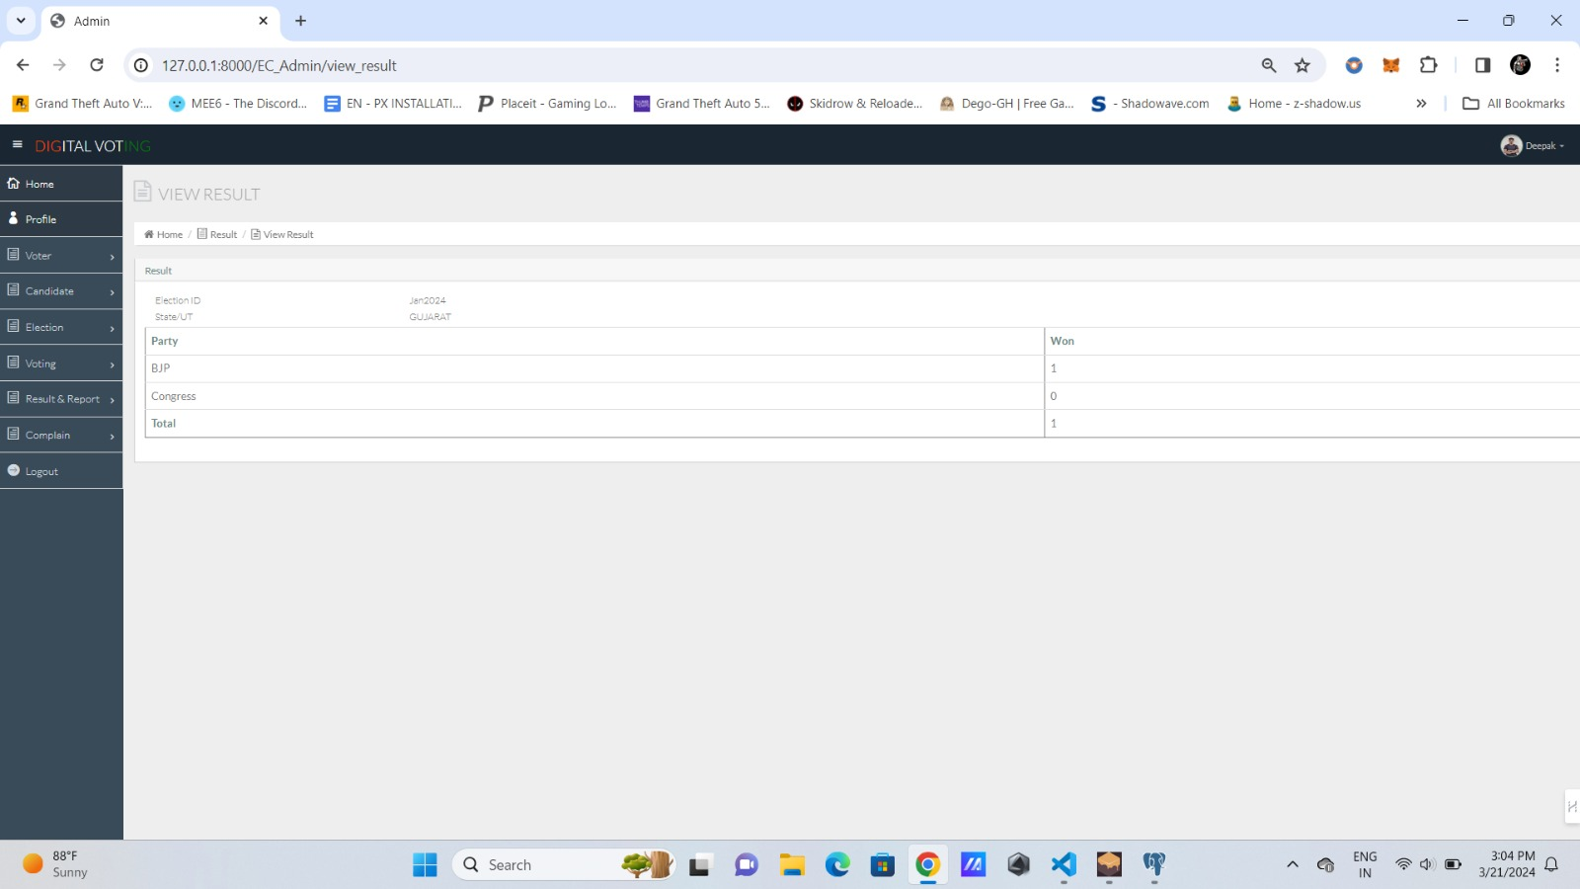

Slide 34
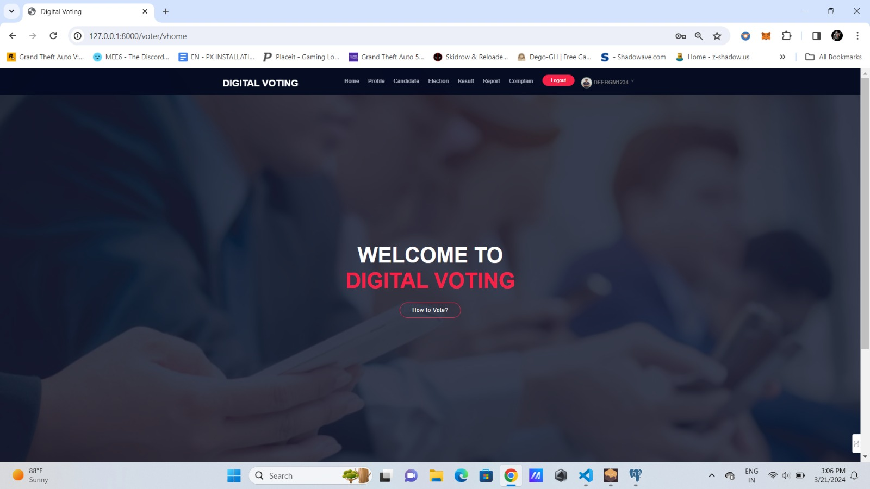

Slide 35
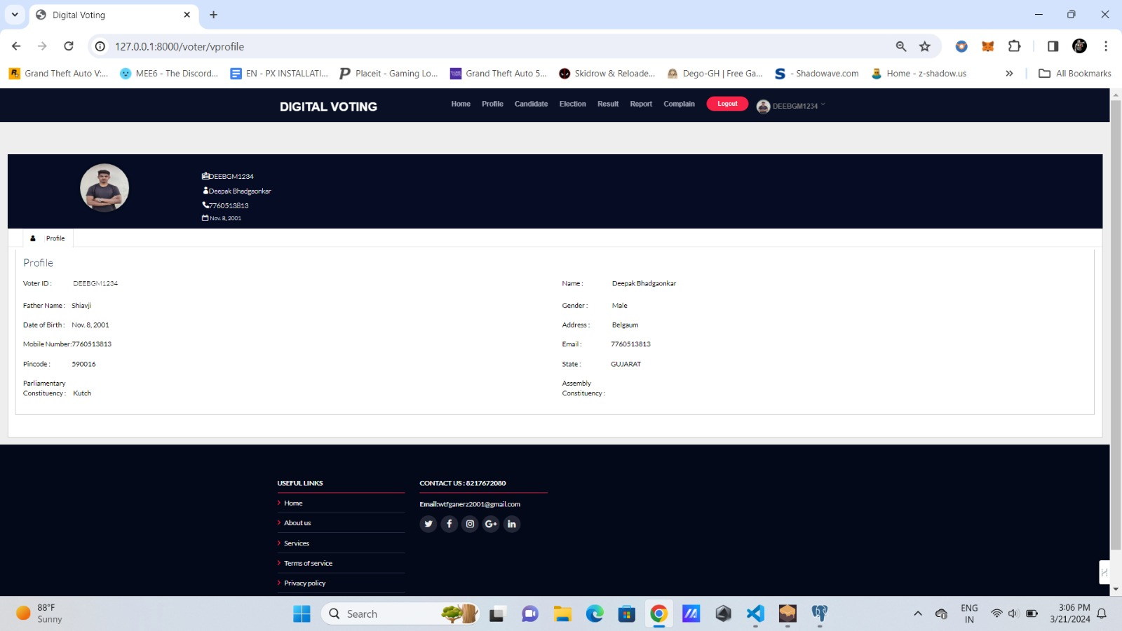

Slide 36
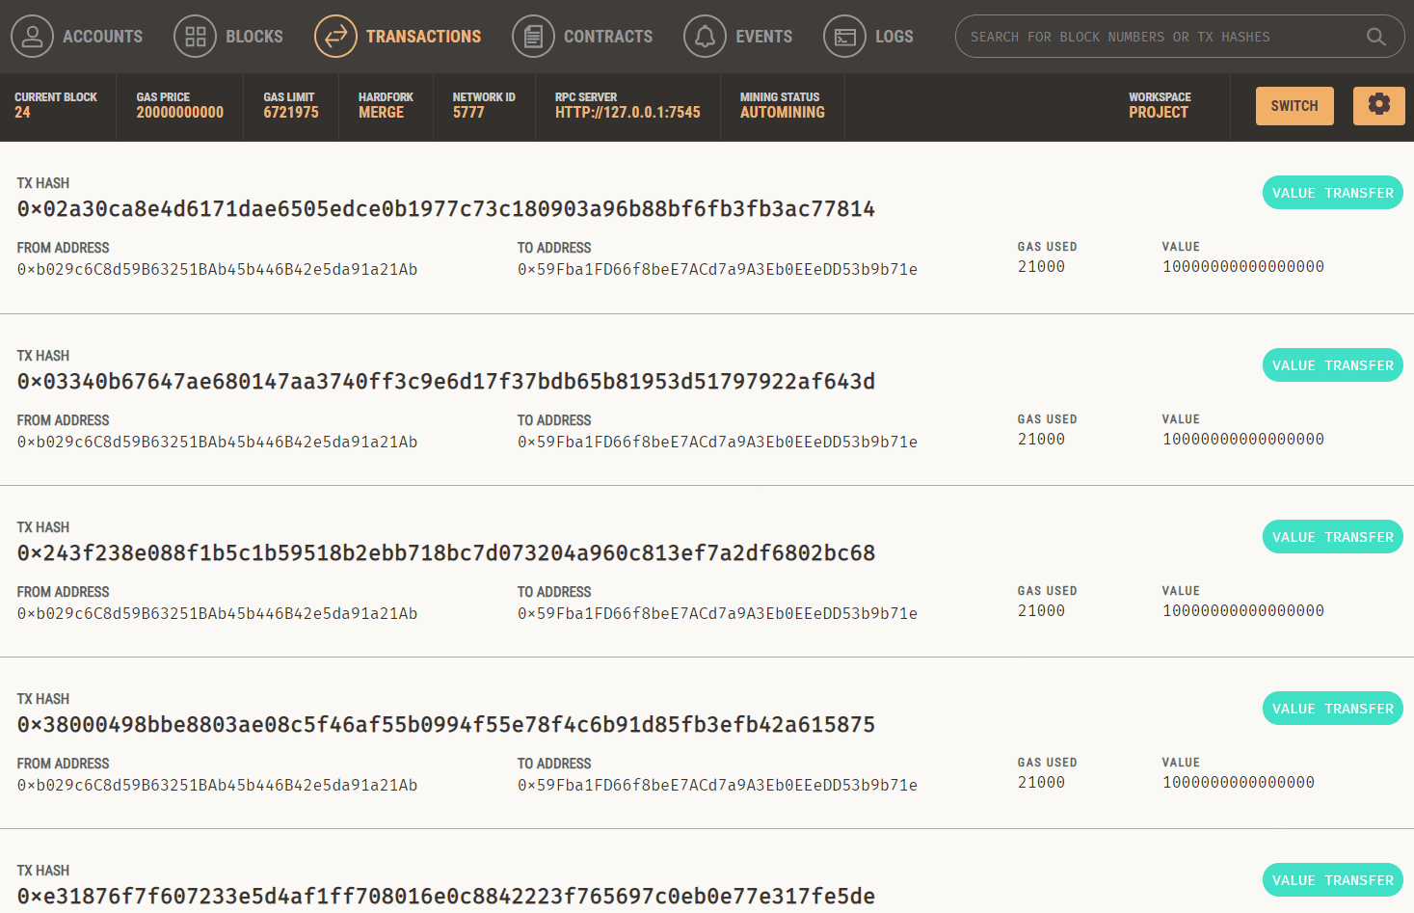

Slide 37
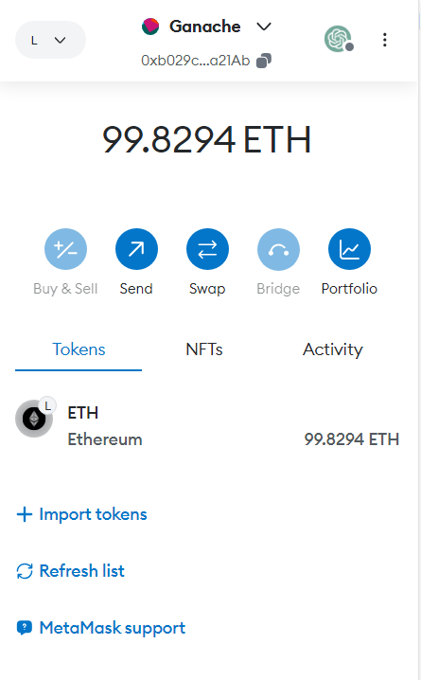

Slide 38
Conclusion and Future enhancement :
Blockchain-secured voting with enhanced identity offers a transformative solution for democratizing elections. By leveraging blockchain's immutable ledger and decentralized architecture, this approach ensures secure, transparent, and accessible voting processes. It safeguards against fraud and tampering while preserving voter anonymity. Real-time verification enhances trust in election outcomes.

Slide 39
Future Enhancements:
Scalability: Making sure the system can handle more voters and transactions by using techniques that allow it to grow without slowing down.
Usability: Making the system easier to use by improving how it looks and works, and adding features like fingerprint or face recognition for logging in.
Privacy: Protecting voters' personal information while still making sure everyone can see the results, using special techniques that allow the system to verify the votes without knowing who voted for whom.
Regulatory Compliance: Working with authorities to make sure the system follows the rules and laws about elections, finding a balance between keeping the election fair and using new technology like blockchain.

Slide 40
References:
T. Dimitriou, ‘‘Efficient, coercion-free and universally verifiable blockchain based voting,’’ Computer. Network., vol. 174, Jun. 2020, Art. no. 107234, doi: 10.1016/j.comnet.2020.107234.
M. S. Farooq, M. Khan, and A. Abid, ‘‘A framework to make charity collection transparent and auditable using blockchain technology,’’ Comput. Electr. Eng., vol. 83, May 2020, Art. no. 106588, doi: 10.1016/j.compeleceng.2020.106588.
S.Park,M.Specter,N.Narula,andR.L.Rivest,‘‘Going from bad to worse: From internet voting to blockchain voting,’’ J. Cybersecurity, vol. 7, no. 1, pp. 1–15, Feb. 2021, doi: 10.1093/cybsec/tyaa025.
Barnes, C. Brake, and T. Perry. Digital Voting with the use of Blockchain Technology Team Plymouth Pioneers-Plymouth University. Accessed: Feb. 14, 2022.
J. Huang, D. He, M. S. Obaidat, P. Vijayakumar, M. Luo, and K.-K.-R. Choo,‘‘The application of the blockchain technology in voting systems: A review,’’ ACM Computer. Survey., vol. 54, no. 3, pp. 1–28, Apr. 2022.

Slide 41
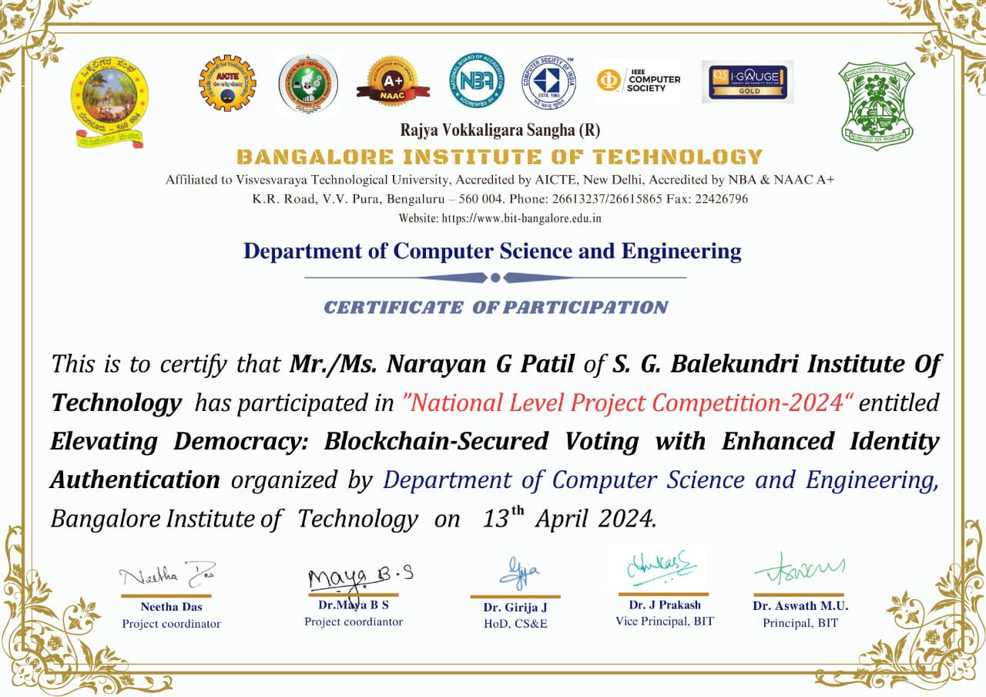
Work Contribution:

Slide 42
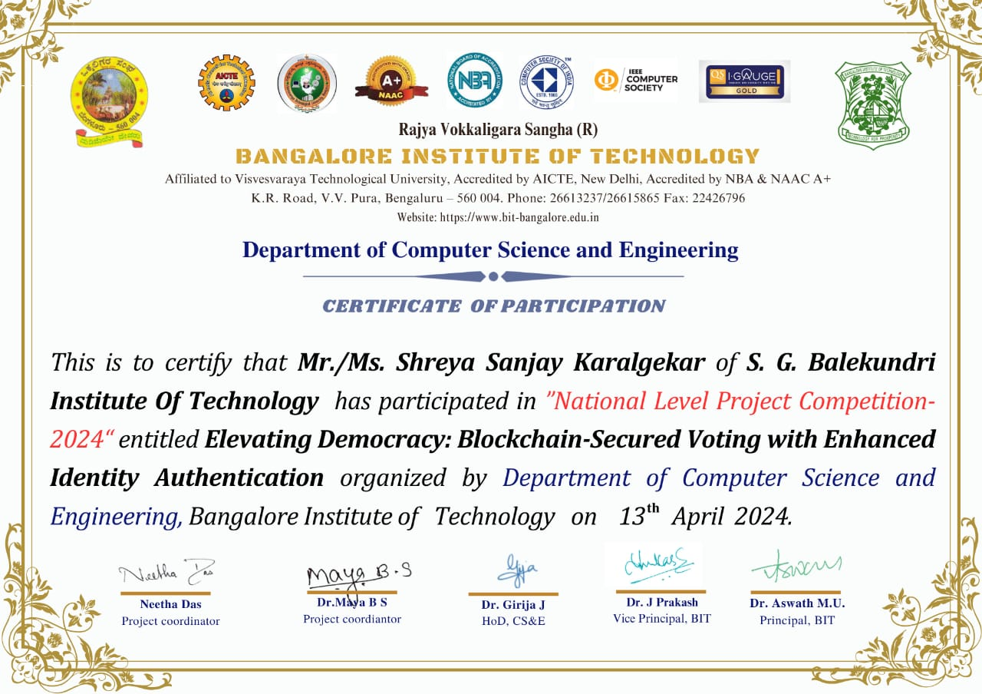

Slide 43
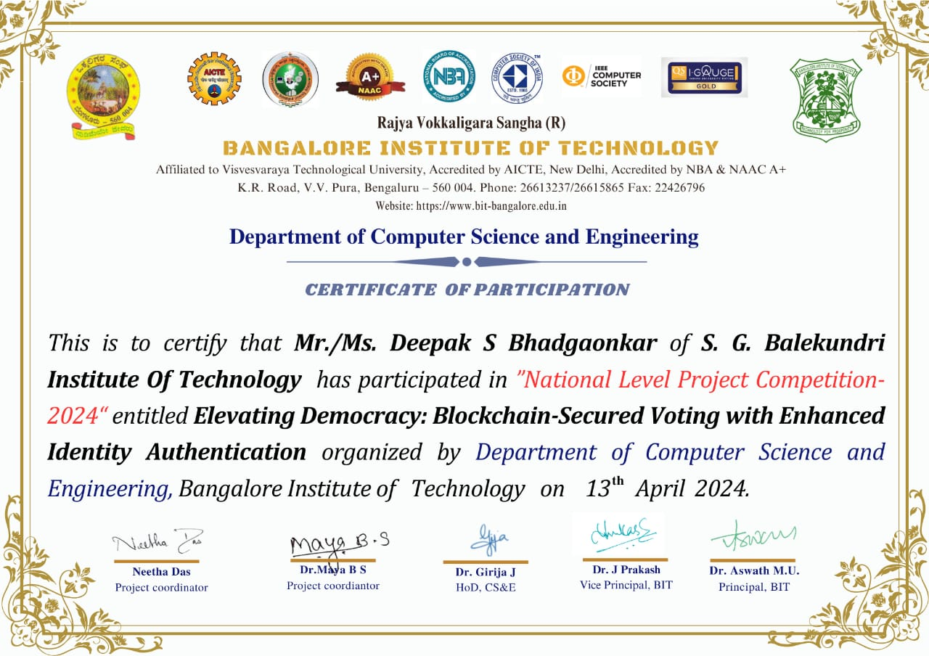

Slide 44
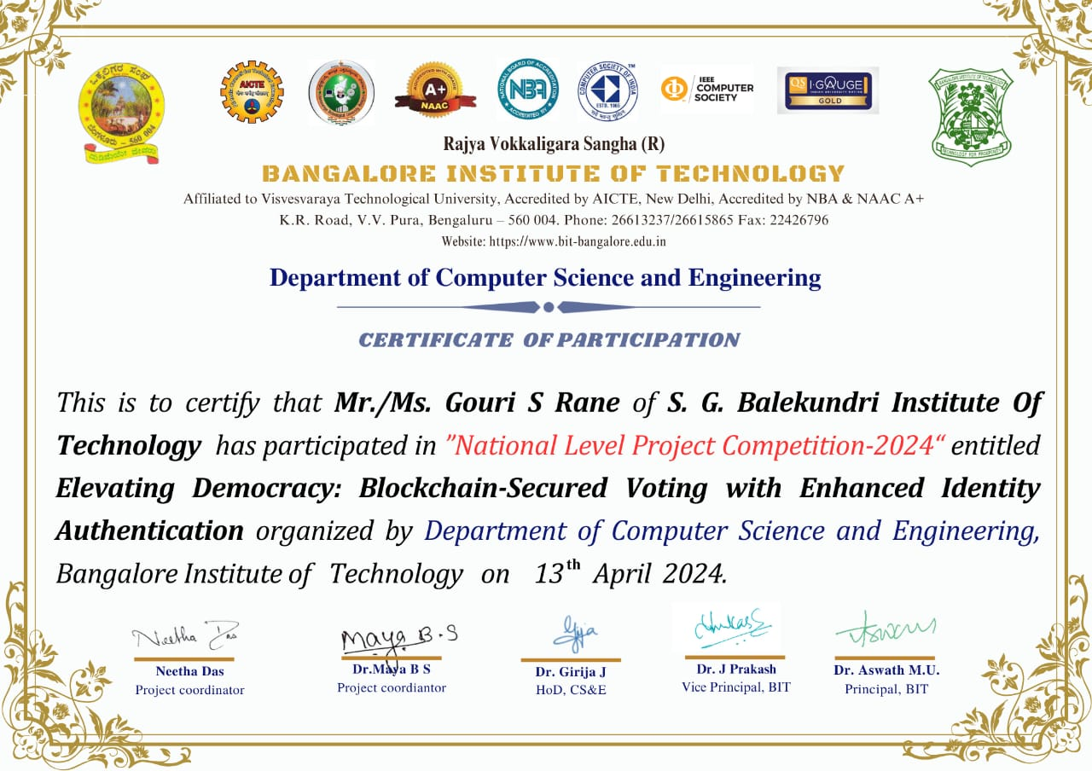

Slide 45
THANK YOU

